Slide 1

TransMaths findings: Engineering
Investigators:
Julian Williams (PI),
Laura Black
Pauline Davis
Birgit Pepin
Geoff Wake
Research Associates:
Valerie Farnsworth
Paul Hernandez-Martinez,
Maria Pampaka
Associate Research Fellow:
Diane Harris
Associate Research Students:
Kamila Jooganah
Irene Kleanthous
Research Statistician:
Graeme Hutcheson
Administrator:
Tim Millar

Slide 2
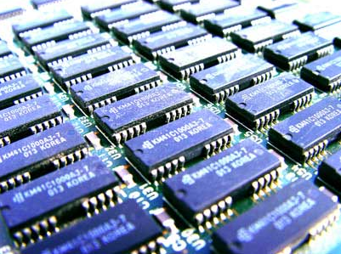
Ravi:
So yeah, I went
through the books
and the questions
and it helped me
quite a lot really.
I mean, like you
know, just that few
one, two hours of
that extra effort; it
paid off a lot in that
diagnostic.
EEE Student, Riverside

Slide 3

Owen:
I don’t think it was well placed in Freshers’ Week
to be honest… especially at nine in the morning. But, I think it’s a good idea, putting us in sets to be honest because I’ve seen what the top set do and that’s just… mad. Like I’d love to be able to do that kind of maths but
I just know like I have to
start at the bottom and work my way up.
EEE Student, Riverside

Slide 4
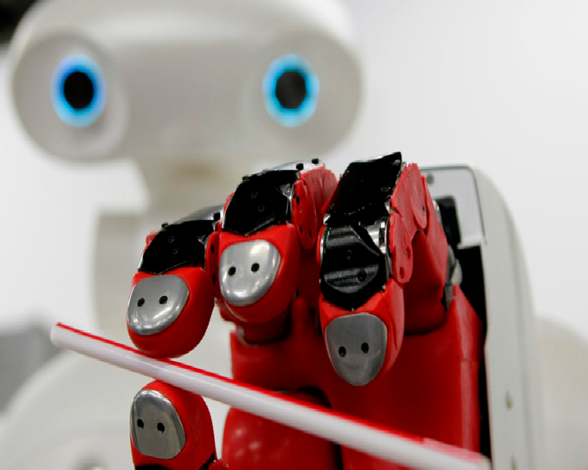
Ellie:
It was like I may as well have been doing a maths degree. The maths felt completely separate. EEE Student, Riverside

Slide 5
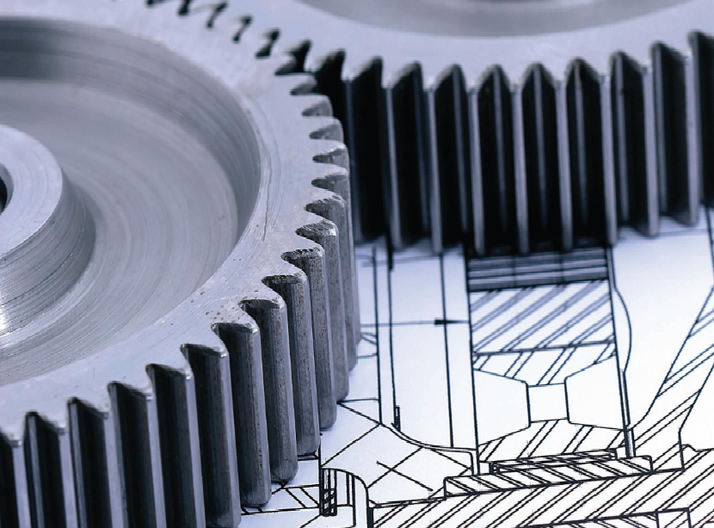
George:
Probably, we have some examples where we go through question sheets in a small group with a lecturer, and I find, I find those are really useful for helping your learning, because they help you apply what you’ve learnt in lectures, in labs to an example and see if your ideas are correct,
and if your methods are
correct, and that’s…I find
that really useful.
EEE Student, Northern

Slide 6
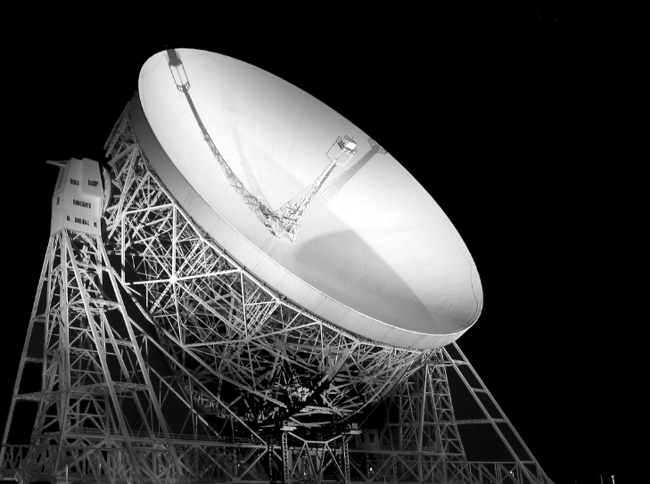
Olufemi:
There’s this guy that, you know, people know him as a ‘geek’ but at the same time he’s really, really smart. Cos one thing I notice is, even the questions he ask at times, I say to myself, ‘wow, how did he think of that?’
EEE Student, Riverside

Slide 7

Female engineering student :
I’m such a ‘lad’ girl, not a ‘girlie’ girl ...
Gender dinosaur:
So have you realised you’re on the wrong course yet?...Well you know it is a bit weird isn’t it?

Slide 8
Implications and Recommendations
The significance of the outcomes of any diagnostic testing needs to be made clear to students in good time.
Consideration needs to be given to how courses and transitional practices can best cater for students with different prior experiences and learning needs, and how specific diagnosed needs are to be addressed.
Students should be given more opportunities to explore mathematics and its place in engineering by rethinking the teaching and learning environment in ways that allow for more individual and collaborative working, with and without the tutors/lecturers/assistants.
University prospectuses should be explicit about the level of mathematical competence required by engineering courses. Also, our research suggests that good pedagogic practices, i.e. connected practices, can make a difference to students' confidence with regard to learning mathematics.
But what do we do about the ‘gender dinosaurs’?

